Slide 1
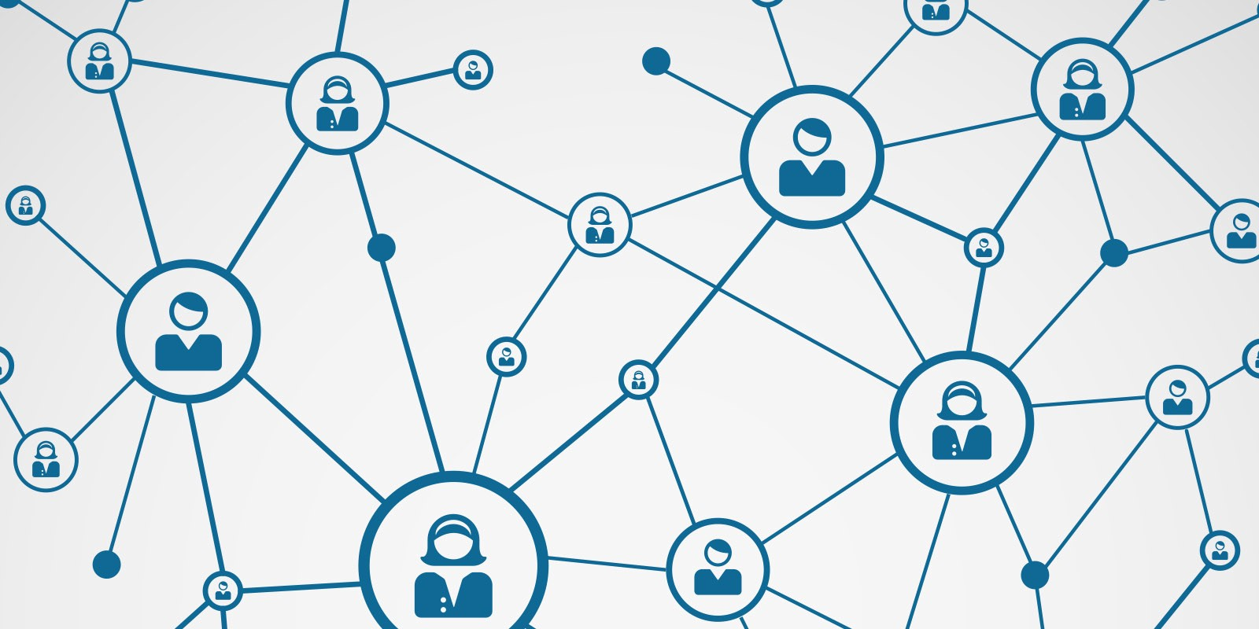
Basic Networking & Reconnaissance
ACM – Cyber Security Chapter

Slide 2
Topics To be Covered
Computer Networking
Networking Models
IP & Ports
5 – stages of Ethical Hacking
Nmap
Wireshark (For packet Analysis only).

Slide 3

About Me!
Syed Basit Khurshid
Red Team Lead – Acm Cyber Security Chapter
Domains Of Interest:-
Cyber Security
Cloud Native Development
Syed Basit Khurshid
Red Team Lead – Acm Cyber Security Chapter

Slide 4
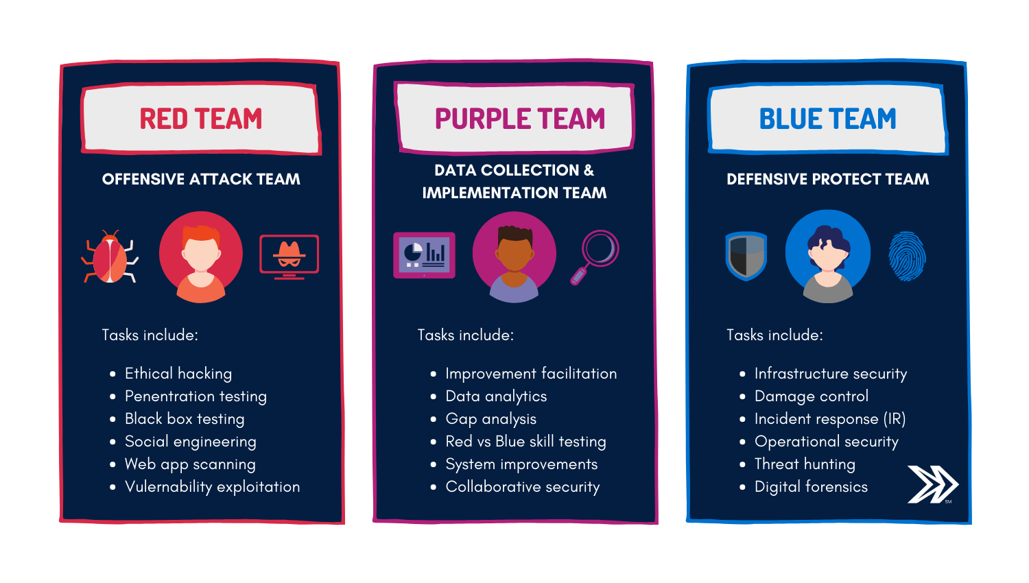

Slide 5
What is Computer Networking?
“Communication between computers”
What is a Protocol?
“A Defined set of standards that computer must follow in order to communicate properly”

Slide 6
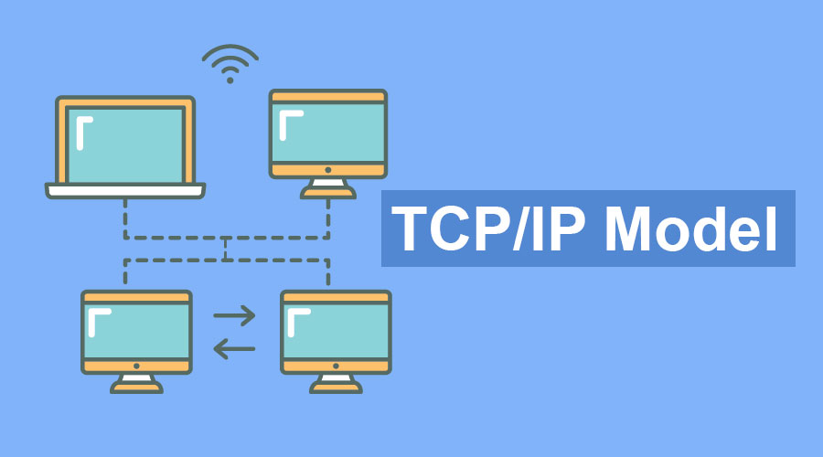
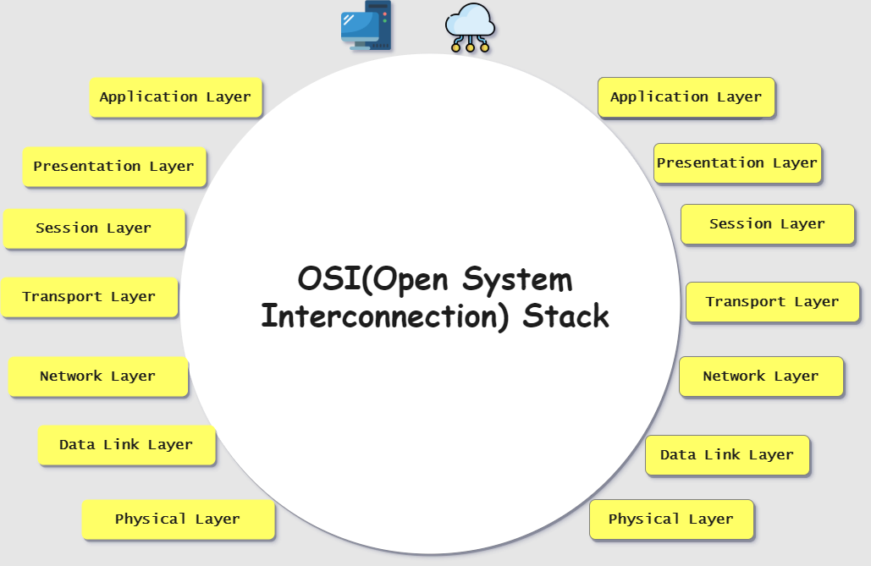
Computer Network Models
TCP/IP
OSI

Slide 7
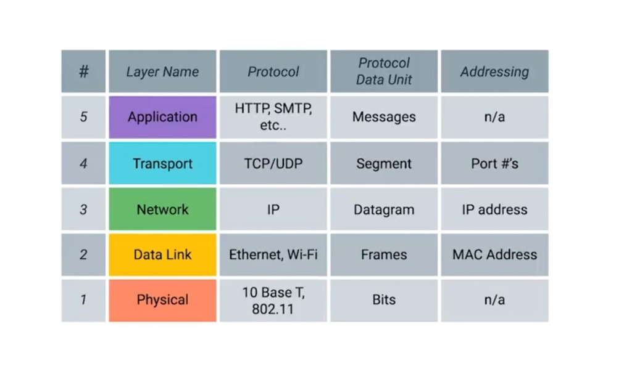
What is TCP-IP Architecture?

Slide 8
Dissecting TCP – IP Architecture
Physcial Layer:
        Physical Connection between computers.
        E.g : Hubs, Switches.
Data Link Layer:
        Also known as Network Interface or Network Access Layer.
        “Define A common way of interpreting these signals, So network Device can communicate.”
        Ethernet is the most commonly used protocol.

Slide 9
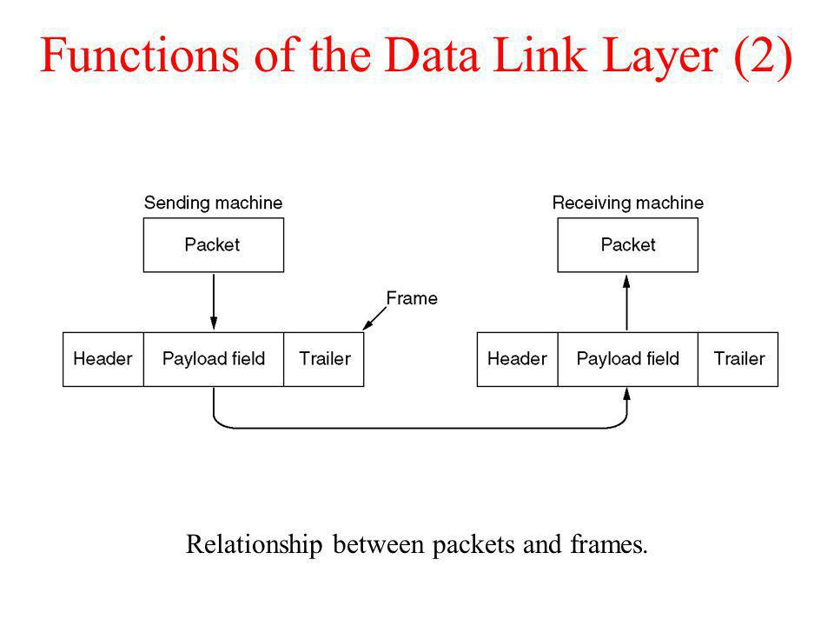
Dissecting TCP – IP Architecture

Slide 10
Dissecting TCP – IP Architecture
Network Layer/Internet Layer:
          “Allows Different networks to communicate with each other through devices Known as Routers.”
          IP or Internet Protocol is the famous protocol.
          Others protocols are ARP, ICMP.

Slide 11
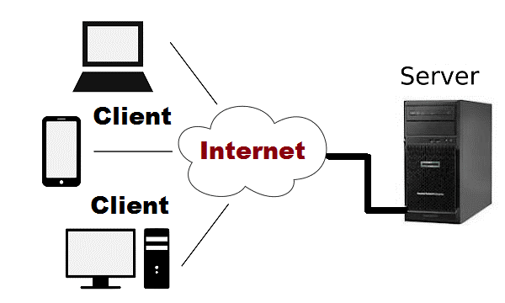
Dissecting TCP – IP Architecture

Slide 12
Dissecting TCP – IP Architecture
Server:
        Anything which serves something.
        Could be a hardware or a software.
Client:
        Anything which requests something.
        Could be a hardware or a software.
A device can be both A server and A client at the time.

Slide 13
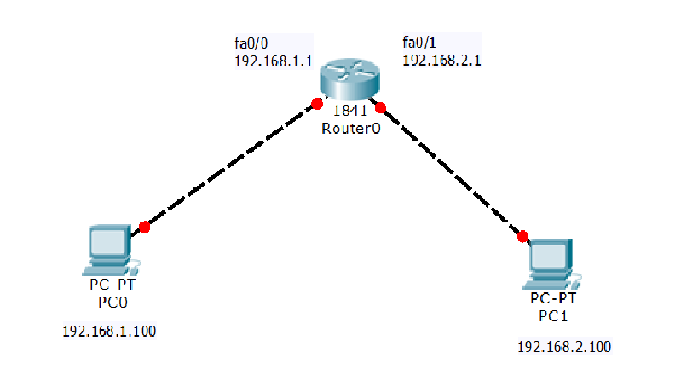
Dissecting TCP – IP Architecture

Slide 14
Dissecting TCP – IP Architecture
Transport Layer:
            “Sorts out which client and server programs are supposed to get that data.”
            2 protocols are used TCP & UDP.
            TCP is a connection oriented Protocol.
                E.G ssh, ftp, Telnet and etc.
            UDP is non-connection oriented Protocol.
                Video streaming.

Slide 15
Dissecting TCP – IP Architecture
Application Layer:
        This is the data itself which is going to be transmitted.

Slide 16
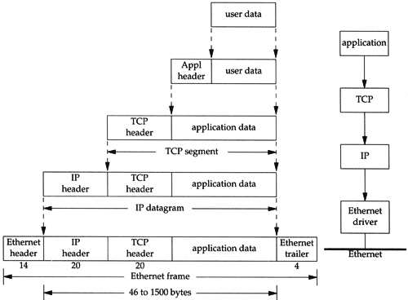
Encapsulation TCP – IP Architecture

Slide 17
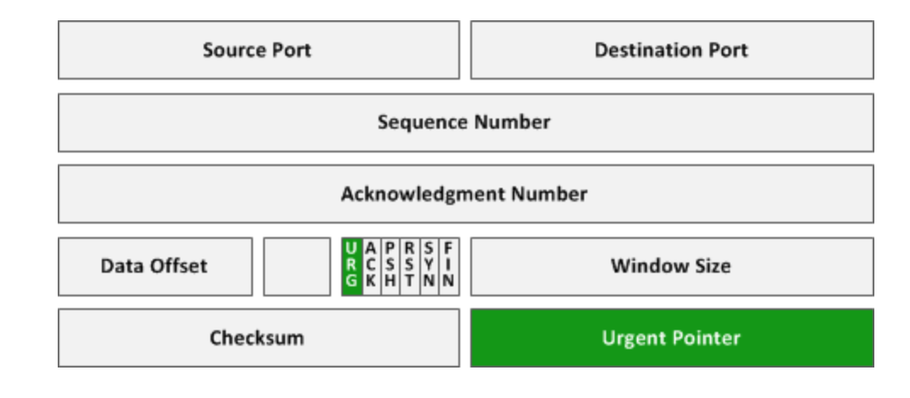
TCP – Header

Slide 18
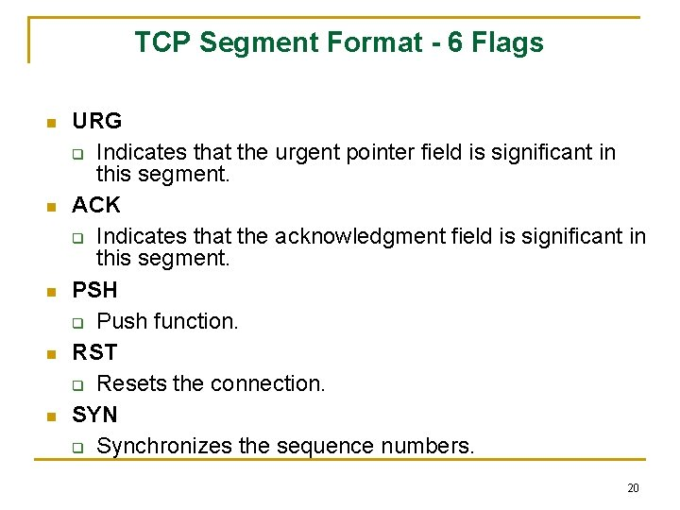

Slide 19
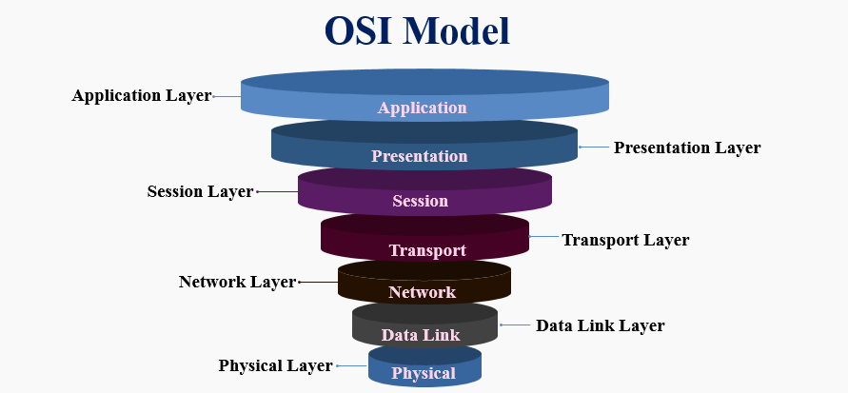
What is OSI – Architecture?

Slide 20
What is OSI-Architecture?
Presentation Layer:
        Prepares Data for Application Layer.
        Defines how 2 devices should Encode, Decode, encrypt and compress data so it is received correctly on the other side.
Session Layer:
        Responsible for establishing, managing, synchronizing, and terminating sessions between end-user application processes.

Slide 21
What are the Ports?
Virtual Point where network connections starts and end.
A gateway to open a service just like ports in a city.
Total no of ports in a computer are 65535
Some common services running on different ports are :
        20/21 : FTP (File Transfer Protocol)
        22 : SSH (Secure Shell)
        23 : Telnet
        25 : SMTP (Simple Mail Transfer Protocol)
        53 : DNS (Domain Name System)
        80 : HTTP (Hyper Text Tranfer Protocol)
        443 : HTTPS (Hyper Text Transfer Protocol Secure)

Slide 22
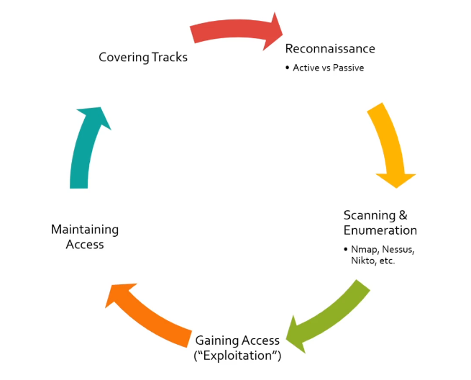
The 5 – Stages of Ethical Hacking

Slide 23


